Slide 1

ODSC Hackathon
Team name: Critical Care
Project name: Happy Moments :)
Using Ultrasound to predict birth weight at 40 weeks
Date 07/10/2016
Team members: Gianluca Campanella, Dalton Coker , Raya Belinsky, Dawud Rahman, Nori Denes, Paola Gasparini

Slide 2
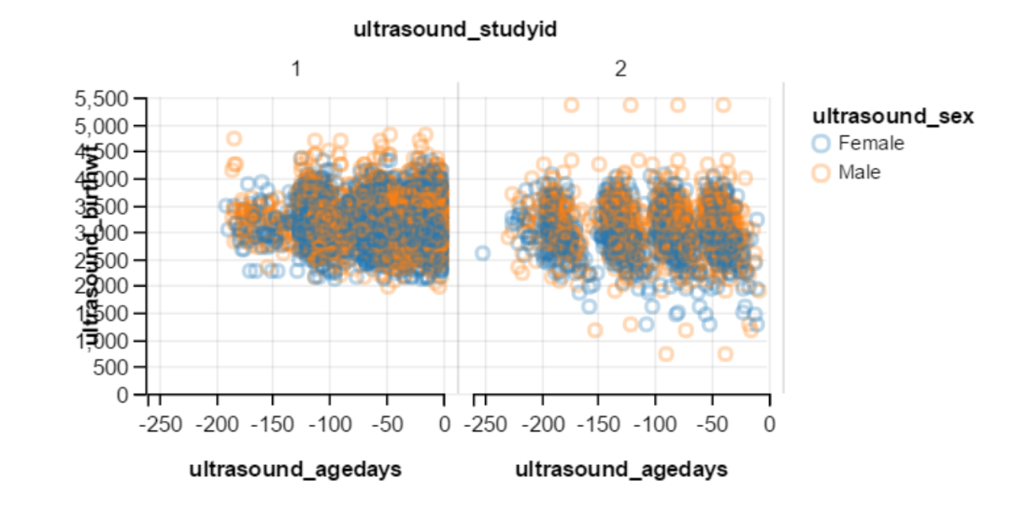
Using Ultrasound to predict birth weight at 40 weeks
Data Exploration & Preparation
Examine dataset where age < 0, so that we consider pre-birth weight only
Identified:
Study 1 - high income, Parity < 2
Study 2 - medium income, Parity 0-7
Ignored missing cases
Graph of Birth weights by Sex for Study 1 and Study 2

Slide 3
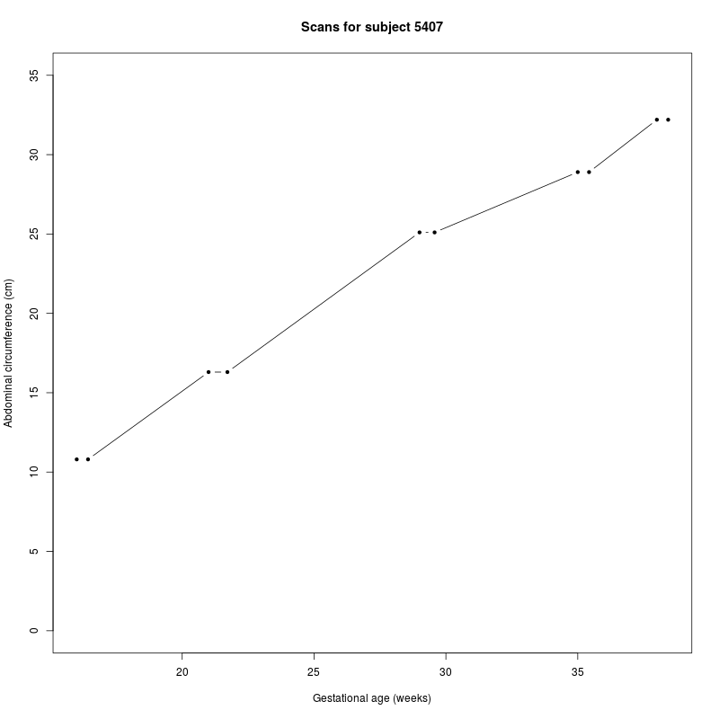
Data Exploration
Parity vs number of pregnancies
Multiple scans

Slide 4
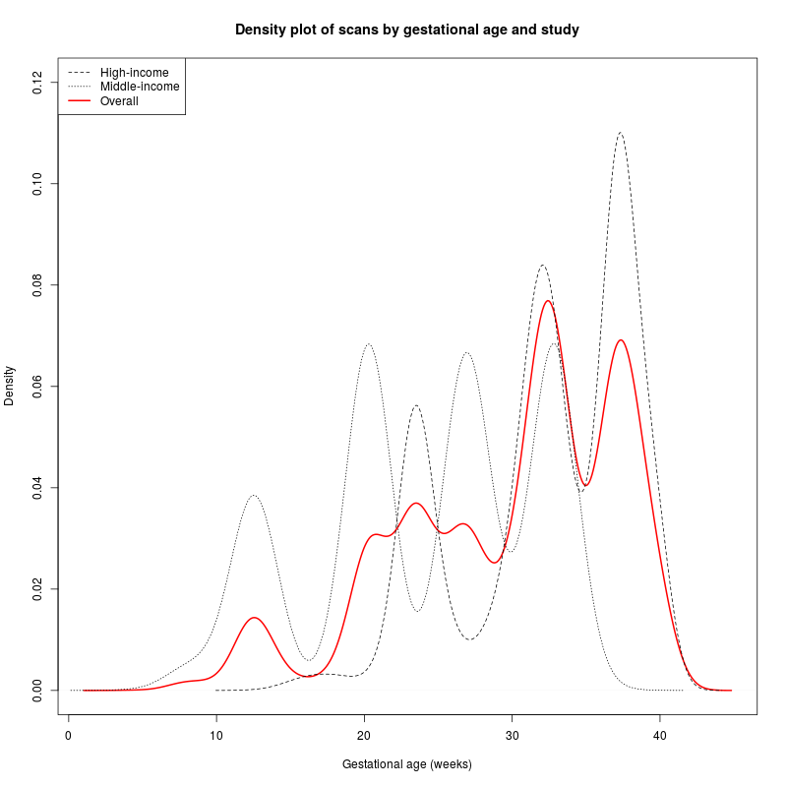
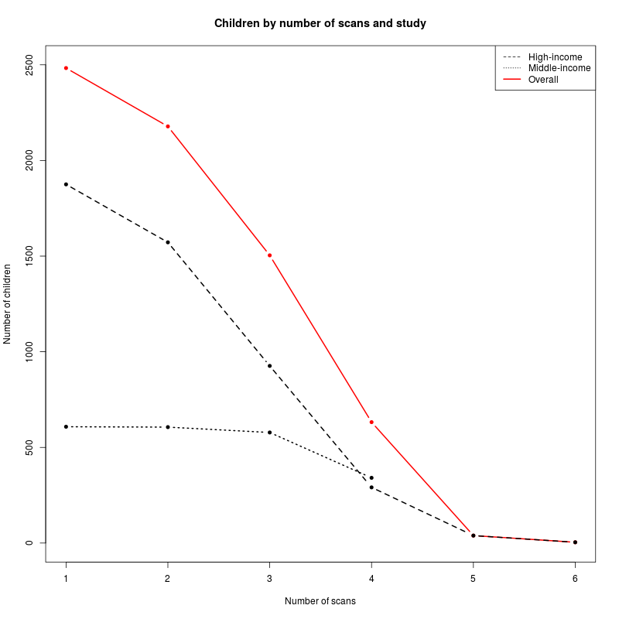
Timing and number of scans

Slide 5
Variables
Existing
Sex
Parity (0, 1, 2, 3+)
First pregnancy (binary)
Four ultrasound measurements:
Abdominal circumference
Biparietal diameter
Femur length
Head circumference
Outcome: log-transformed full-term weight
New
Ultrasound measurements:
Squared
Cubed
All pairwise ratios
First-order differences
First-order differences divided by time differences
Missing values recoded as 0 + indicator variable for missingness

Slide 6
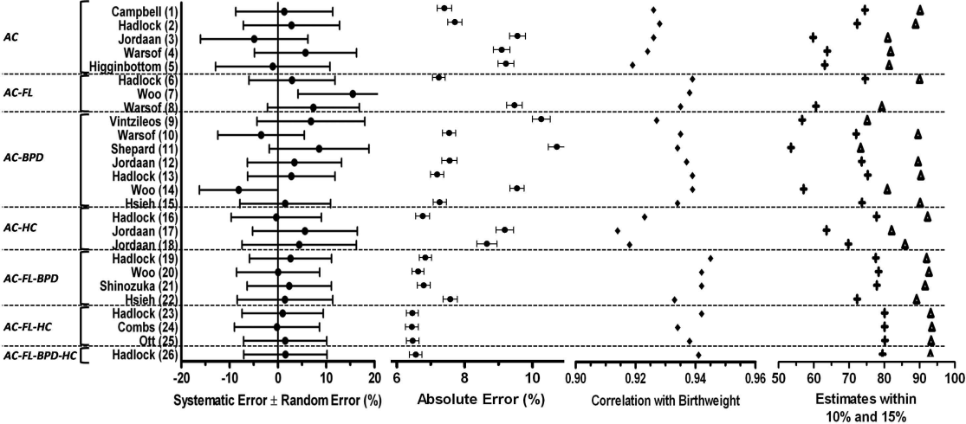
Evaluation

Slide 7
Models
We tried:
Linear regression
Regularised regression (LASSO/Ridge)
Decision trees + AdaBoost
Random forests
Using:
Last scan only
Last two scans
Last three scans
All 6 scans (if available)
‘Best’ model
Last three scans
Elastic Net
MAPE ≈ 7.4% (MAE ≈ 0.24 kg)
This can be improved by:
Adding scans closer to delivery back in (MAPE ≈ 6.4%)

Slide 8
What we learnt
Higher FT weight outcomes for high-income country (from Study 1)
Male/female differences
Small effect of parity and first pregnancy
Males have greater variance in FT weight compared to females → Difficult to get accurate prediction for poorer males
Positive correlation between weight and height.
Difficult to improve on existing models… but we use cross-validation! :-)

